Slide 1
Pocket Sommelier
A project by
Alyza Wiener
Reena Desai
Daniel Kim

Slide 2

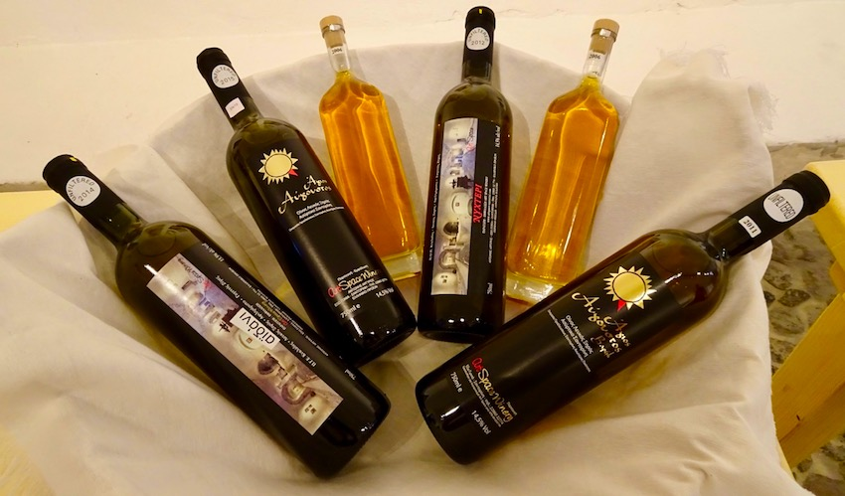
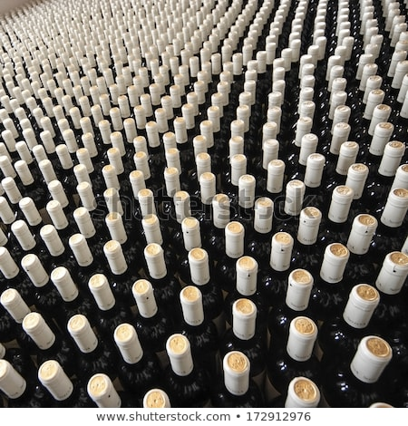




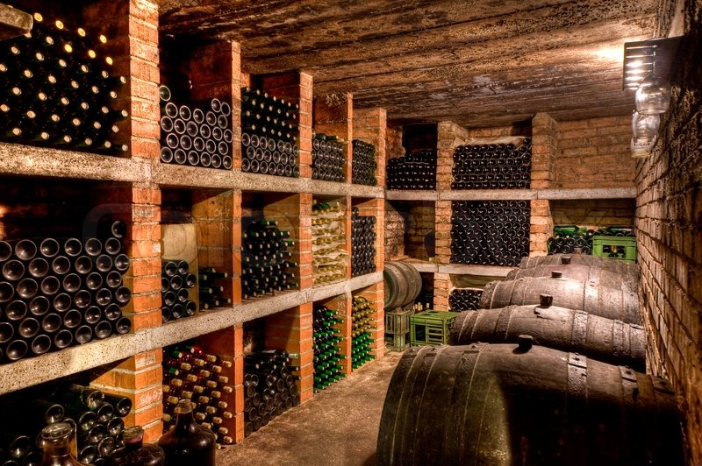

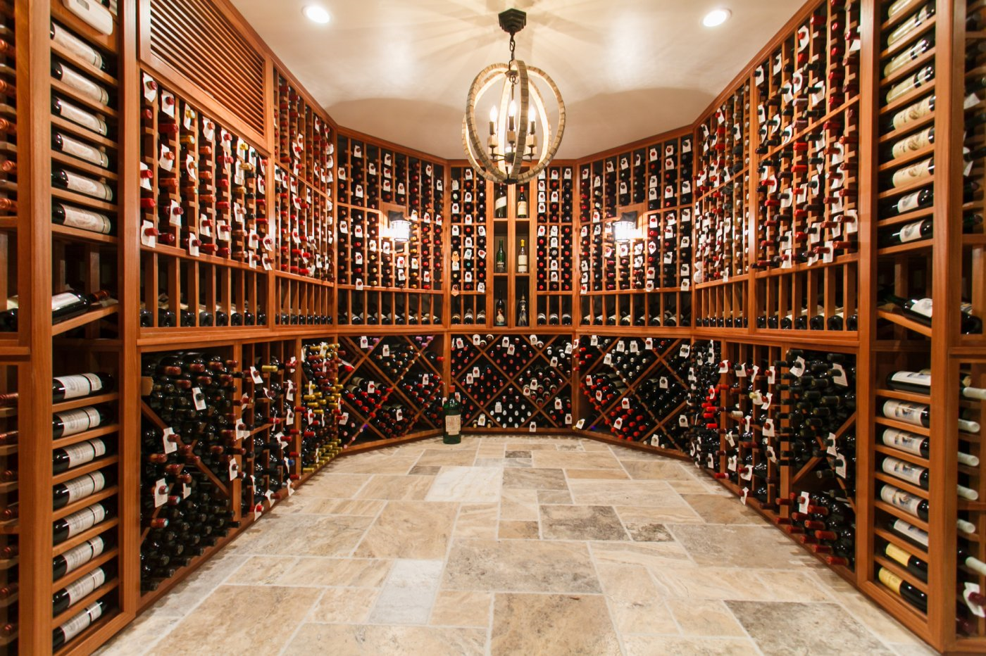
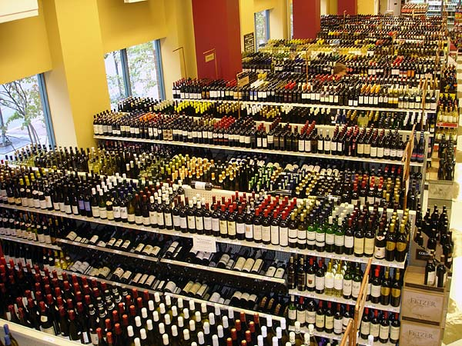
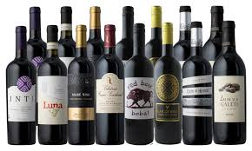

Slide 3


Slide 4











Slide 5

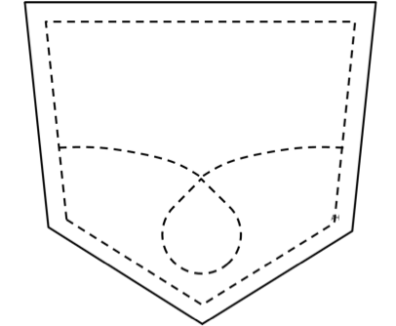
Pocket Sommelier

Slide 6
Our (Null) Hypotheses
Ratings for expensive wines will be comparable to cheaper wines
Ratings for older wines will be comparable to newer wines.
Prices of older wines will be comparable to newer wines

Slide 7
Finding Our Data
Dataset derived from www.kaggle.com.
Zack Thoutt scraped the data from WineEnthusiast on November 22nd, 2017.
Dataset contains 129,970 rows of wine data to include the following wine details:
Title
Variety of wine
Year
Price
Grade (rating)
Winery
Province
Country
Description
Wine Taster’s name
Wine Taster’s Twitter review
Dataset Source: https://www.kaggle.com/zynicide/wine-reviews/version/4#winemag-data-130k-v2.csv

Slide 8
Our original Data – No column for Year, but…
So our plan was to..
1. Split the title string into string elements, then pull out digits.
2. Append it to a new list

Slide 9
But exceptions…
Some titles have no numbers.
Some titles have numbers that are not years.
Some titles contain multiple years.

Slide 10
My solution

Slide 11
More clean ups
Removing duplicates, wines without year or price
Removing low-count countries and years.

Slide 12
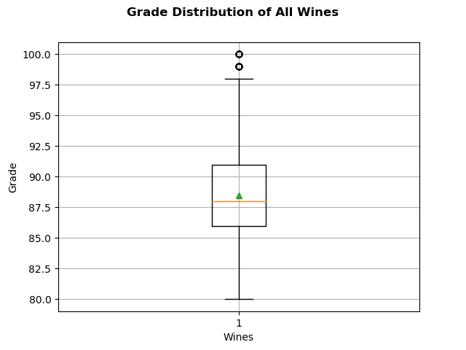
Analysis
Dataset had a wide range of prices for the world’s wines.
There are 101,085 in this dataset.
Cost of wine at the 10th percentile $13
Cost of wine at the 25th percentile $17
Cost of wine at the 50th percentile $26
Cost of wine at the 75th percentile $43
Cost of wine at the 90th percentile $65
Most expensive wine cost $3300
Cheapest wine cost $4
Median cost of wine is $26
Average cost of wine is $36
Maximum Grade is 100
Minimum Grade is 80
Median Grade is 88

Slide 13
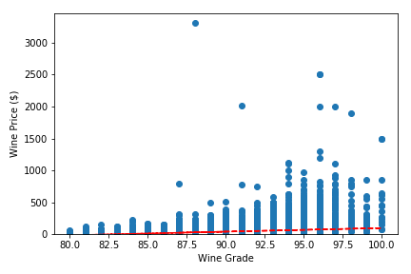
Analysis
There is a positive correlation between the cost of the wine and the rating. (Slope = 5.64)
Wine Data

Slide 14

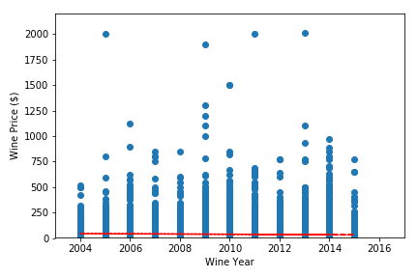
Analysis
There is a very slight negative correlation between the cost of the wine and the year it was made. (Slope = -1.02)

Slide 15
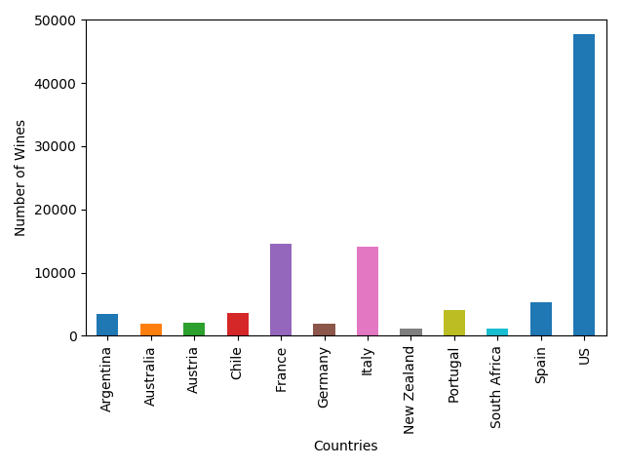
Analysis
US wines vastly outnumber other countries’ wines in our dataset.
Country | Wines
US | 47,699
France | 14,617
Italy | 14,098
Spain | 5,329
Portugal | 4,128
Chile | 3,677
Argentina | 3,436
Austria | 2,118
Germany | 1,925
Australia | 1,840
New Zealand | 1,147
South Africa | 1,071

Slide 16
Limitations
Ratings were not conducted blindly.
Our database was limited to wines that scored 80+ points by reviewers.
Our database consists overwhelmingly of US wines.

Slide 17
Check out our app!

Slide 18
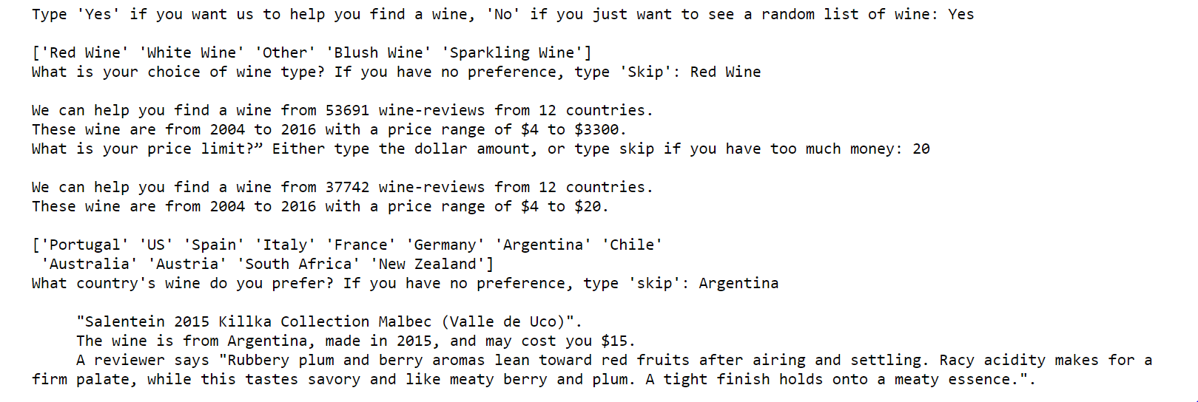
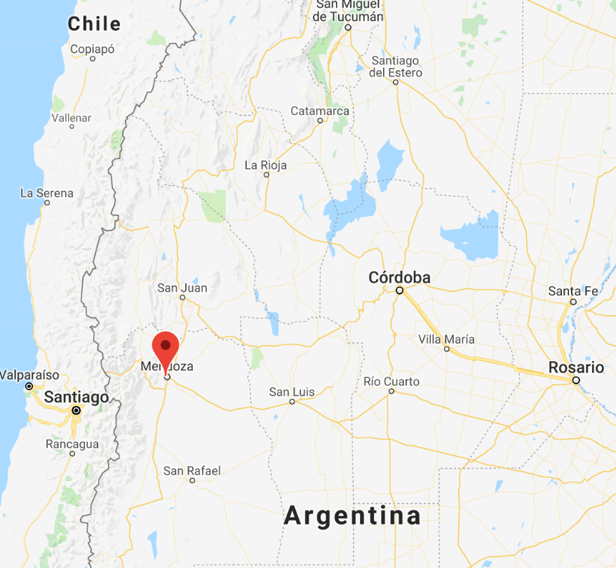
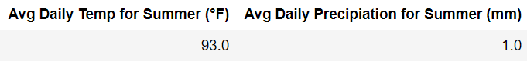
Wine Finder Example

Slide 19
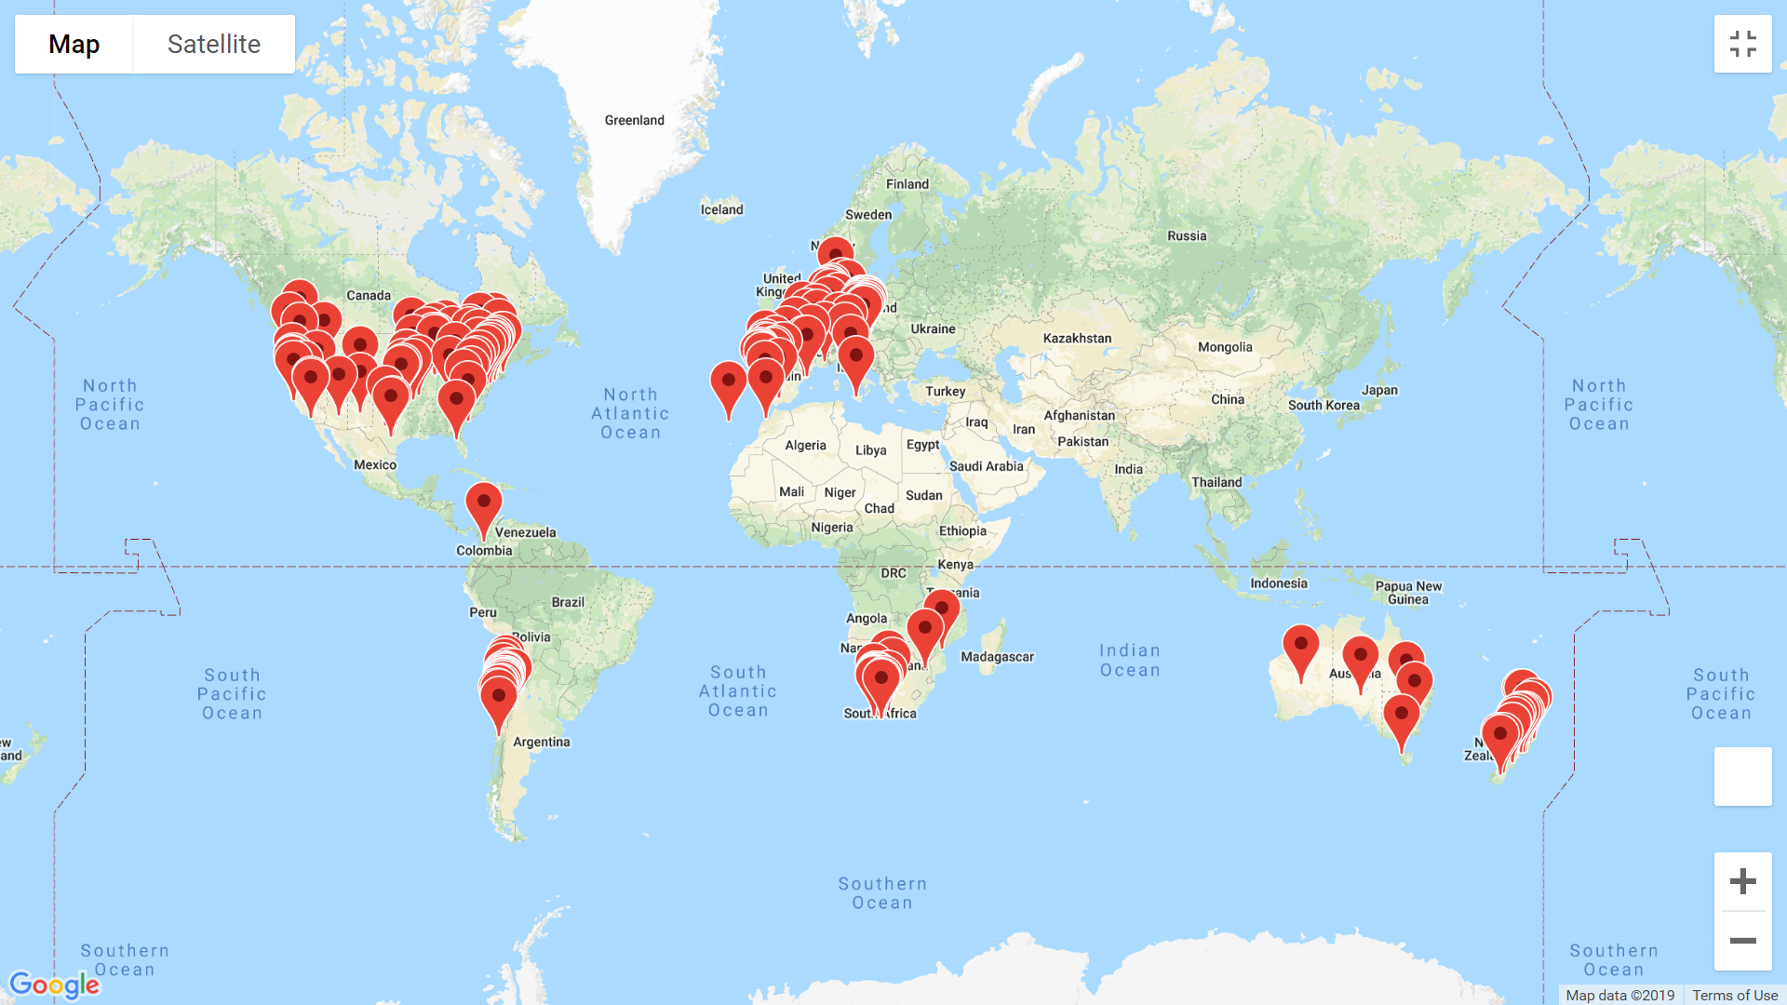
Global Distribution of Our Wines

Slide 20


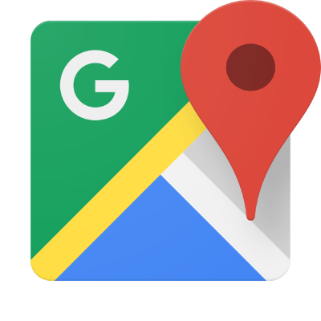

Using APIs

Slide 21
Limitations
There were too many distinct wineries to pull geolocation data (without spending $$$).
Google API occasionally pulls incorrect location if search yields multiple results, and skews towards US locations.

Slide 22
Conclusion

Slide 23

*Cheap*
^

Slide 24
Cheers, Dartlings!

